Slide 1

AHA! Healthcare Insights Analyzing Patient Trends and Hospital Care in the Aha Region
DataLab Analytics Internship Project
BY
TIWA DAODU

Slide 2

Questions to be answered
Introduction
Every year, thousands of patients visit hospitals in the Aha region with diverse medical needs.
Understanding how patients use healthcare services over time reveals patterns that improve care and resource planning.
This project examines patient data from November 2018 to November 2023, including demographics, medical conditions, treatments, and billing.
These records uncover trends in admissions, treatment use, and hospital performance, showing how healthcare was delivered in the region over five years.
Analyze patient demographics and their impact on hospital admissions.
Identify the most common medical conditions among patients.
Examine admission patterns and their changes over time.
Investigate billing trends and cost variations across patient groups.
Assess medication use and treatment effectiveness.
Evaluate hospital performance based on discharge rates and patient outcomes.
Analysis was done using Microsoft Excel

Slide 3

Data Cleaning and Calculations
About the dataset
This dataset covers patient hospital visits in the “Aha” region, from November 2018 to November 2023.
Contains patient demographics including age, gender, and blood type
Medical information such as condition, test results, length of stay, day of admission and discharge
Include hospital and insurance provider information for each admission
Billing date, noting the cost of treatment for each patient.
Grouped ages into ranges using a helper column to enable easier demographic analysis.
Length of Stay = Discharge date - Admission date
Created categorical bins for Length of Stay (e.g., 1–5 days, 6–10 days)
Classified treatment effectiveness based on test results into “effective” and ineffective” and treatment outcomes in a helper column.
Grouped billing amount into categorical bins [Bronze, Silver, Gold, Platinum, Diamond).

Slide 4
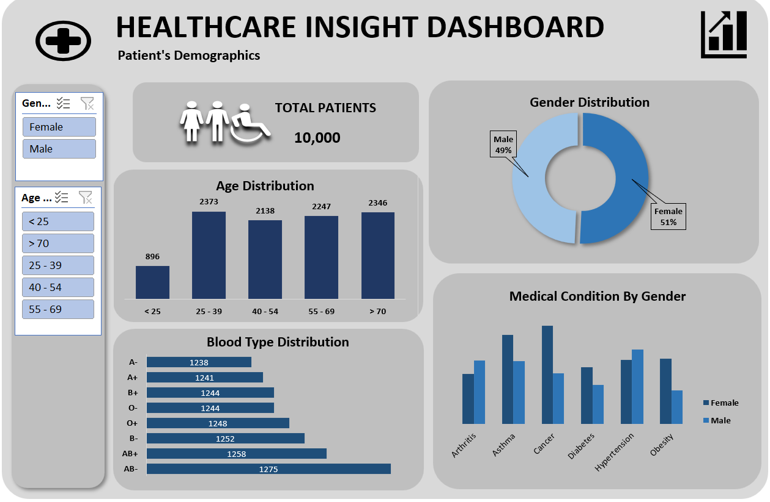
Out of 10,000 patients, females slightly outnumbered males (51%).
The majority of patients were aged 25–39 years (23.73%), highlighting a young adult population.
AB- was the most common blood type among patients, though it remains relatively rare.
Cancer was the most frequent condition among female patients, while hypertension was the most common among males.

Slide 5
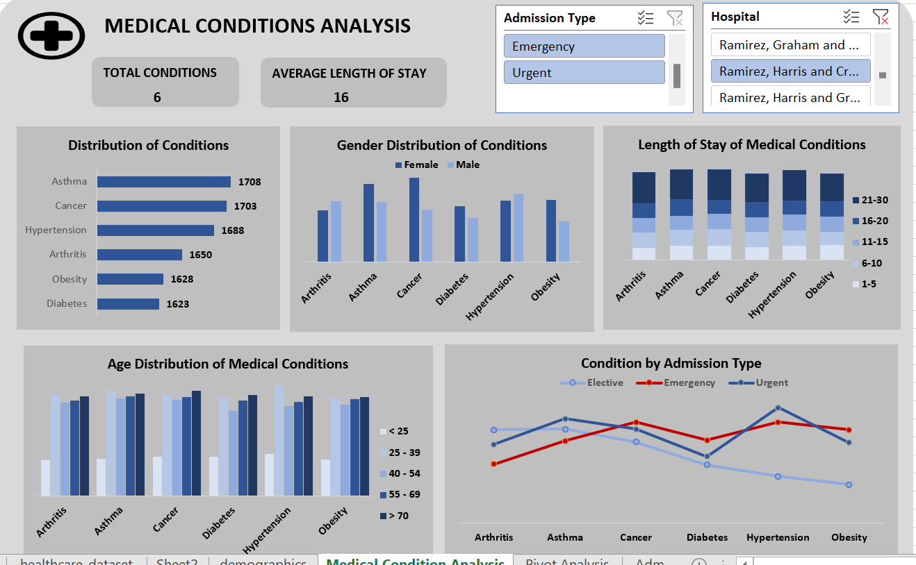
Asthma, Cancer, and Hypertension account for the highest case numbers, while Diabetes is the lowest.
Many patients remain hospitalized for 21–30 days.
Patients aged 40–69 make up most cases, while those under 25 have the lowest incidence.
Female patients have higher cases of Cancer and Asthma, while male patients have higher cases of Hypertension and Obesity.
Urgent and Emergency admissions are more frequent than Elective admissions across conditions.

Slide 6
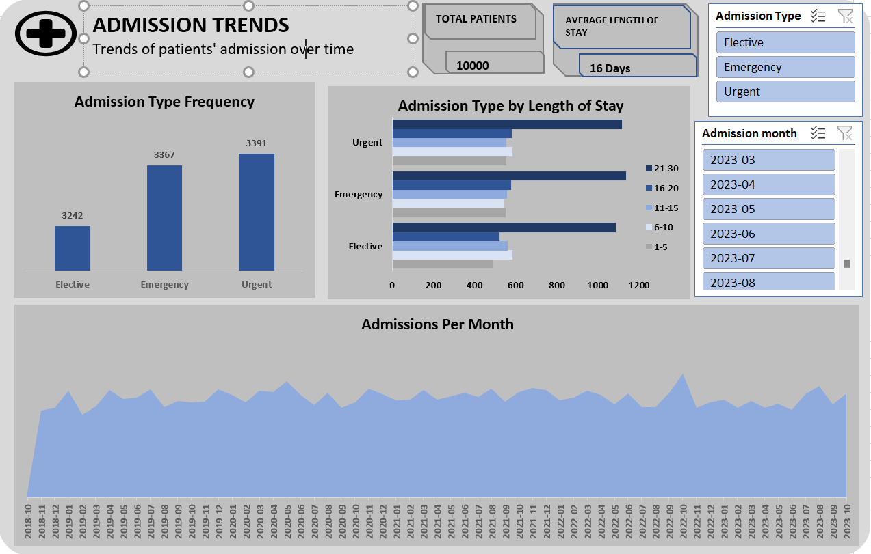
Urgent admissions represent the highest admission type overall.
Longer hospital stays are more frequently associated with Emergency and Urgent admissions compared to Elective cases.
Admission volumes show minor peaks in late May and November 2020, November 2021, October 2022, and August 2023, indicating short-term demand fluctuations.

Slide 7
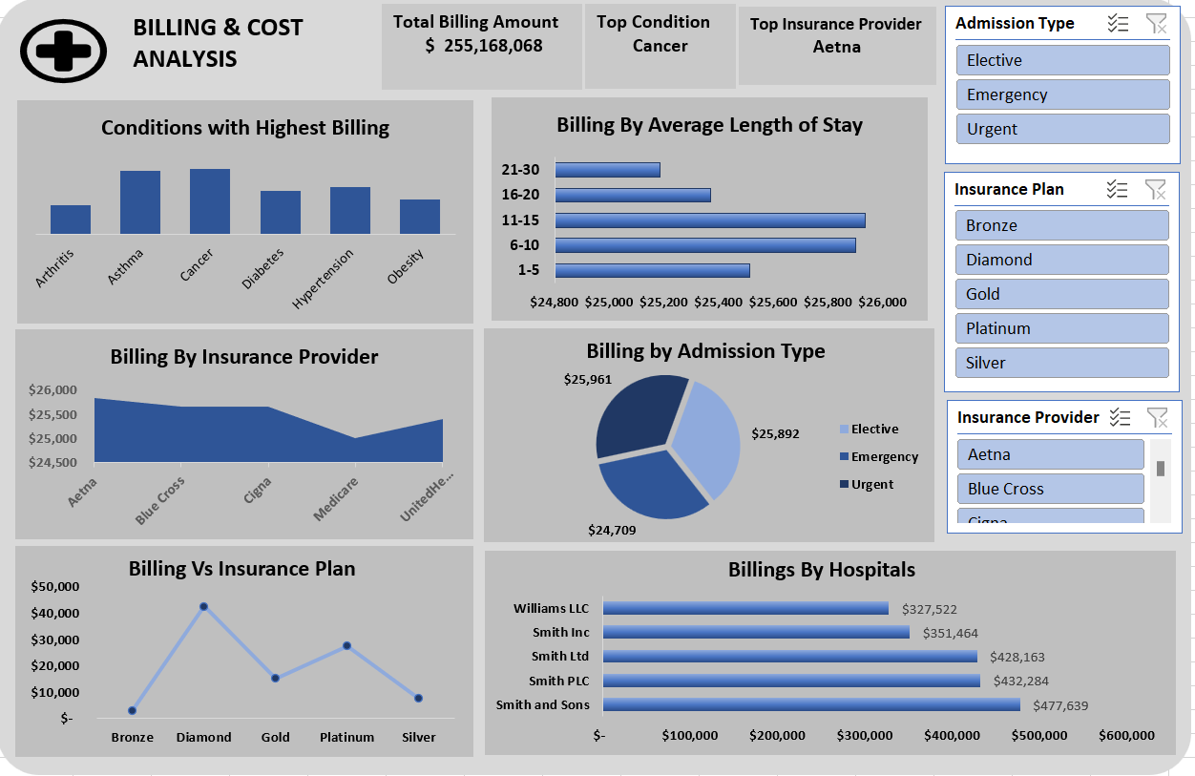
Cancer generates the highest billing among all conditions.
Billing is highest for 11–15 day stays, while extended stays (21–30 days) do not proportionally increase revenue.
The Diamond insurance plan and Aetna contribute the highest billing amounts.
Smith and Sons records the highest billing among hospitals.

Slide 8
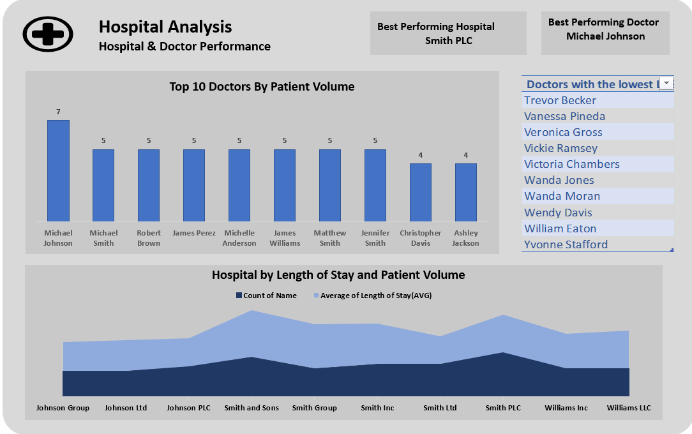
Patient volume among the top 10 doctors is narrowly distributed, with most managing 4–5 patients.
Michael Johnson records the highest patient volume among doctors.
Smith PLC stands out as the best-performing hospital, with higher patient volume and longer average length of stay (LOS).
Hospitals with higher patient counts tend to have longer average LOS
A distinct group of doctors consistently recorded very low patient volumes, indicating underutilization.

Slide 9
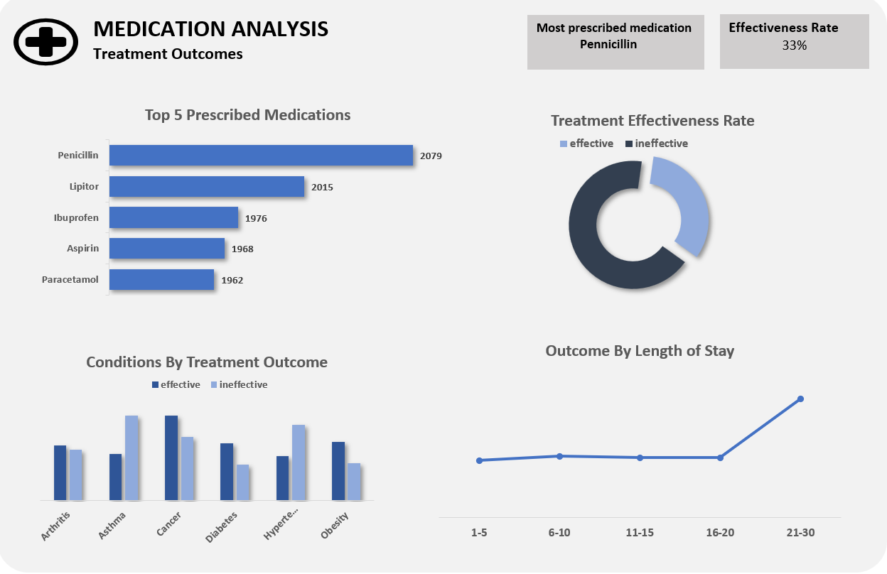
Penicillin is the most frequently prescribed medication.
Overall treatment effectiveness is low, with effective outcomes in about one-third of cases.
High prescription volume does not translate into high effectiveness.
Cancer shows better treatment outcomes, while asthma and hypertension show poorer outcomes.
Longer lengths of stay are associated with poorer outcomes, suggesting prolonged admissions correlate with treatment failure and/or complications.

Slide 10
Recommendations
Prioritize preventive screening, chronic disease management, and lifestyle programs for the 40–69 age group to reduce high-volume conditions.
Strengthen early health education and preventive awareness for those under 25 to maintain a low incidence and promote early seeking of care.
Use standardized clinical pathways and early discharge planning to reduce prolonged hospital stays.
Invest in better oncology care coordination and early detection to improve outcomes while managing costs.
Plan staffing, bed space, and resources ahead of late-year admission peaks to maintain care quality and prevent strain.
Improve contract negotiations and tailor services for high-value insurance plans to optimize reimbursement.
Strengthen clinical reviews and early intervention to improve treatment outcomes and overall efficiency

